Slide 1
React
SE 3355 Web Development
Lect. Barış Ceyhan

Slide 2
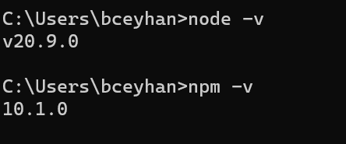
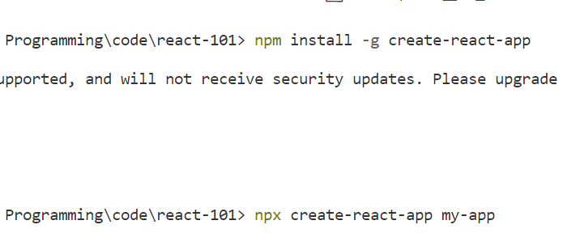
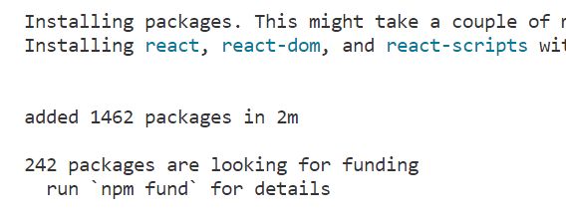
Motivation - install
JS library for developing user interfaces, not MVC or MVT
For creating fast, dynamic pages
Jsx, component based
Benefits
Install node.js and verify - https://nodejs.org
platform for hosting and running web servers for React apps
Go to VS Code - terminal
npm install -g create-react-app
Create your first app
npx create-react-app my-app
cd my-app
npm start

Slide 3
Quick start
https://react.dev/learn
Class component vs functional component
jsx
Defining components
Responding to events
Using hooks
Thinking in react!

Slide 4
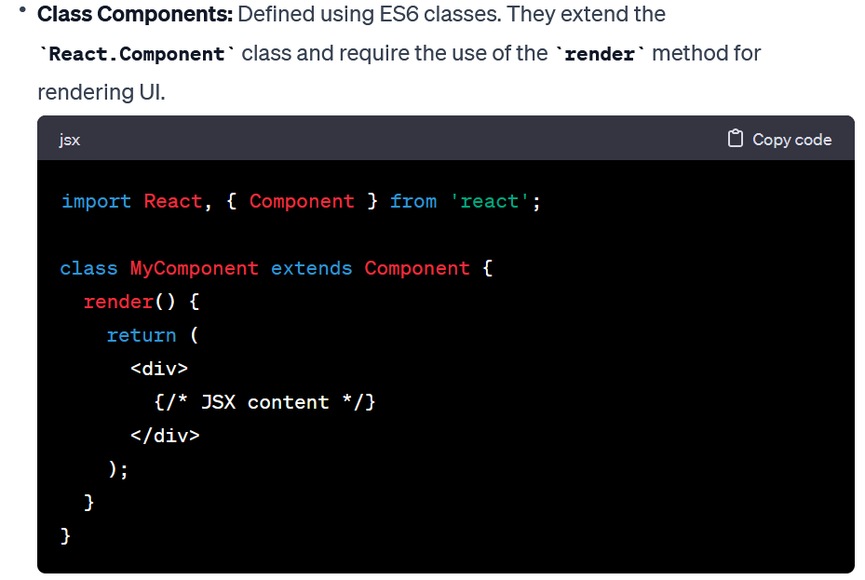
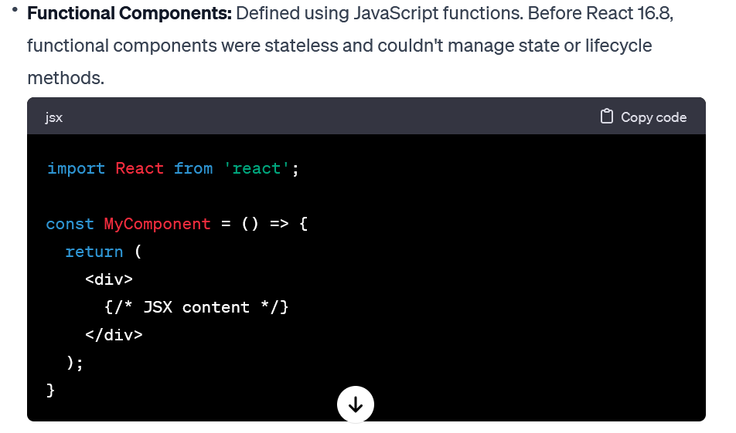
Class vs Functional

Slide 5
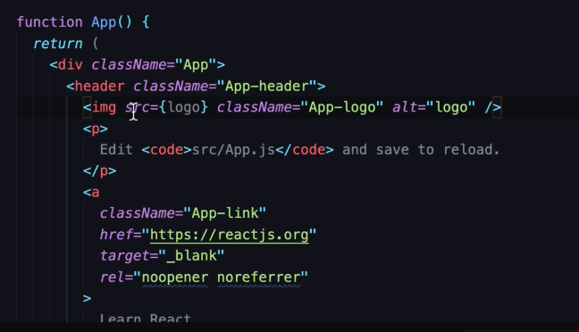
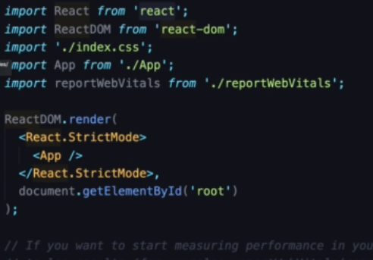
Class based components
jsx – unusual syntax
Review App.js – where everything happens initially
className?
Change some text.
Compile on each save
Import
Logo , css. Change some css
Index.js – where app gets rendered

Slide 6
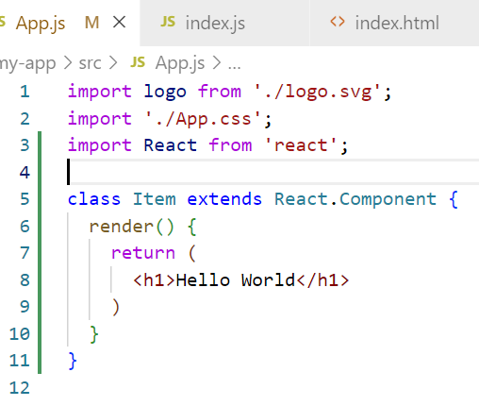
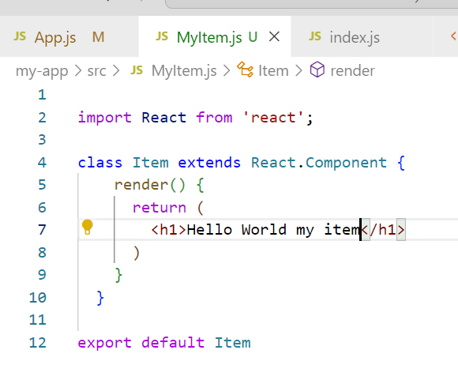
First component
Modular work. Do once use many times
Keep in a different file. Export, import

Slide 7
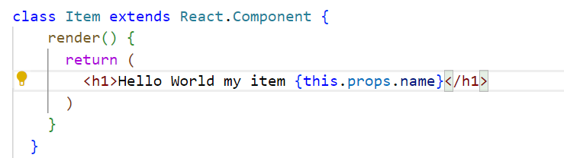

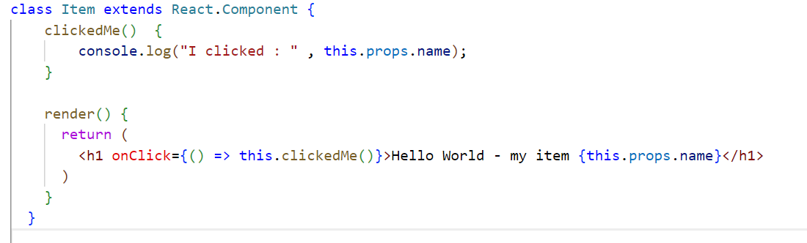
Component Props
this.props
onClick example

Slide 8
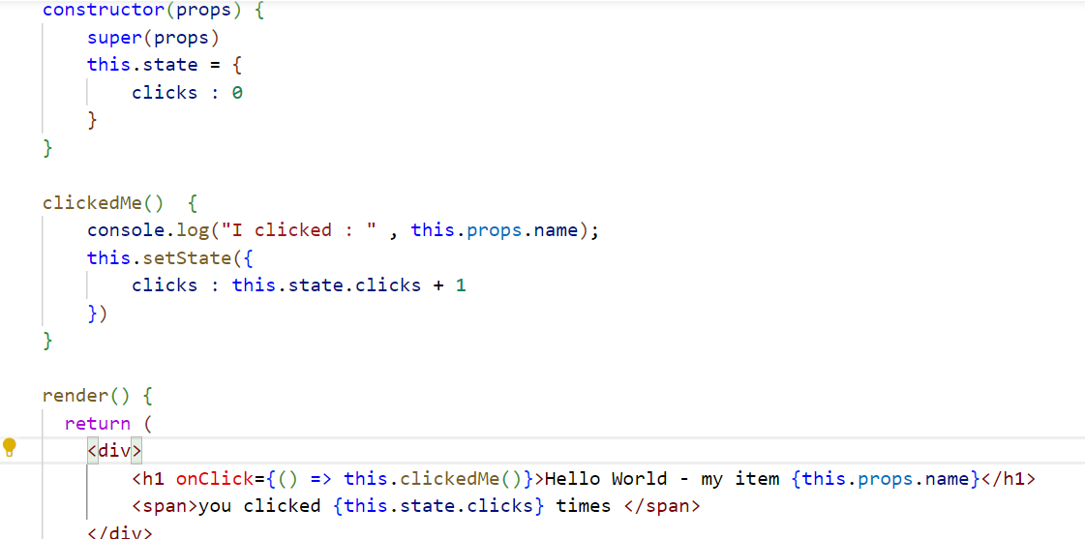
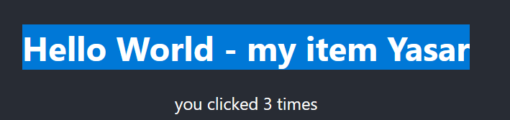
setState
Keep global variable for modules
Like a dictionary, keep many variables

Slide 9
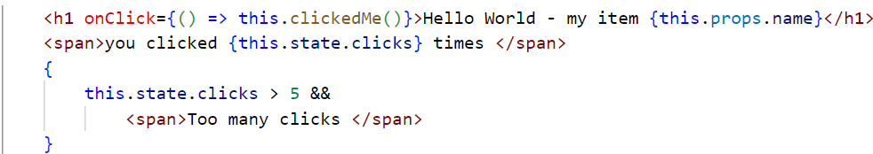
if, loop
https://www.w3schools.com/react/react_conditional_rendering.asp
https://www.w3schools.com/react/react_lists.asp
{
this.state.clicks > 5 &&
<span>Too many clicks </span>
}

Slide 10
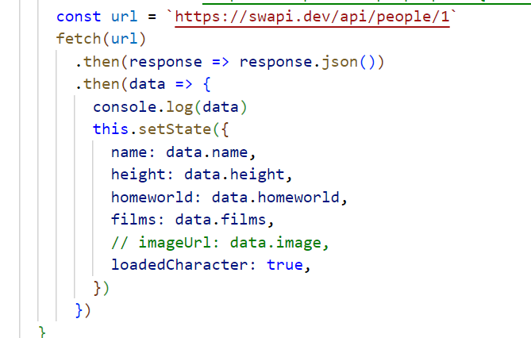
API request
fetch then
See Starwars example

Slide 11
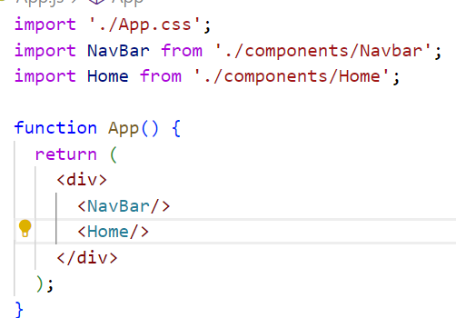
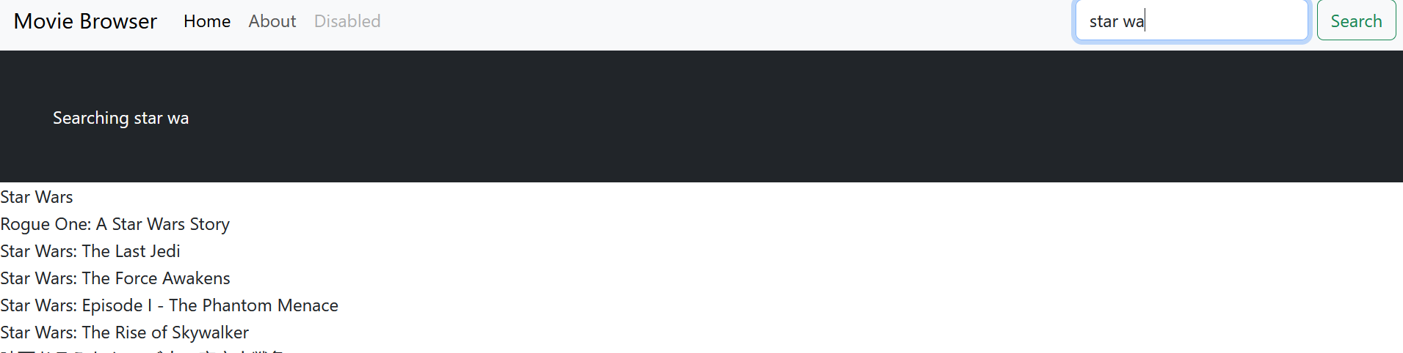
Functional components
Easier to use
Faster
Lets do
API call
a page with menus and more functionality
Router
npm install react-router-dom
Component props
useState, useEffect

Slide 12
https://react.dev/learn
https://react.dev/learn/state-a-components-memory

